Slide 1



PROJECT PRESENTATION
PHASE 3
S-12
VEHICLE MONITORING SYSTEM
USING IOT
Supported by: Bosch Limited, Adugodi
Under the guidance of:
Prof. Navya Holla K
Presented by:
Ch Midula 1DS16EC713
Isiri S 1DS16EC717
Nayana S A 1DS16EC735
Rachana Nagaraj 1DS16EC740

Slide 2
PO - PSO Mapping
PO | LEVEL (3/2/1) | JUSTIIFICATION
PO 1 | 3 | Applied knowledge of Embedded Systems, Analog Electronic Circuits, IoT.
PO 2 | 3 | Analyze research papers on clutch wear out and AdBlue in BS6 engine.
PO 3 | 3 | Design solution for a Vehicle Monitoring system
PO 4 | 2 | Attempt to find a solution for maintenance of small parts.
PO 5 | 2 | Use of Thingspeak, LabVIEW, Angular JS, NodeMCU
PO 6 | 3 | Provide better alert system to vehicle users and information to the service center.
PO 7 | 3 | In order to comply with the emission norms to reduce NOx released.
PO 8 | 2 | Committed to professional ethics and norms of Engineering.
PO 9 | 3 | Everyone equally understood and participated in the project.
PO 10 | 2 | Presentation to industry professionals and for further presentations.
PO 11 | 2 | Project financial needs have been analyzed by planning the budget.
PO 12 | 2 | More efficient ways of utilization can be found.
PSO 1 | 2 | To deploy this prototype in actual vehicles for testing.
PSO 2 | 1 | Integrated hardware and software by using sensors and creating a website.

Slide 3
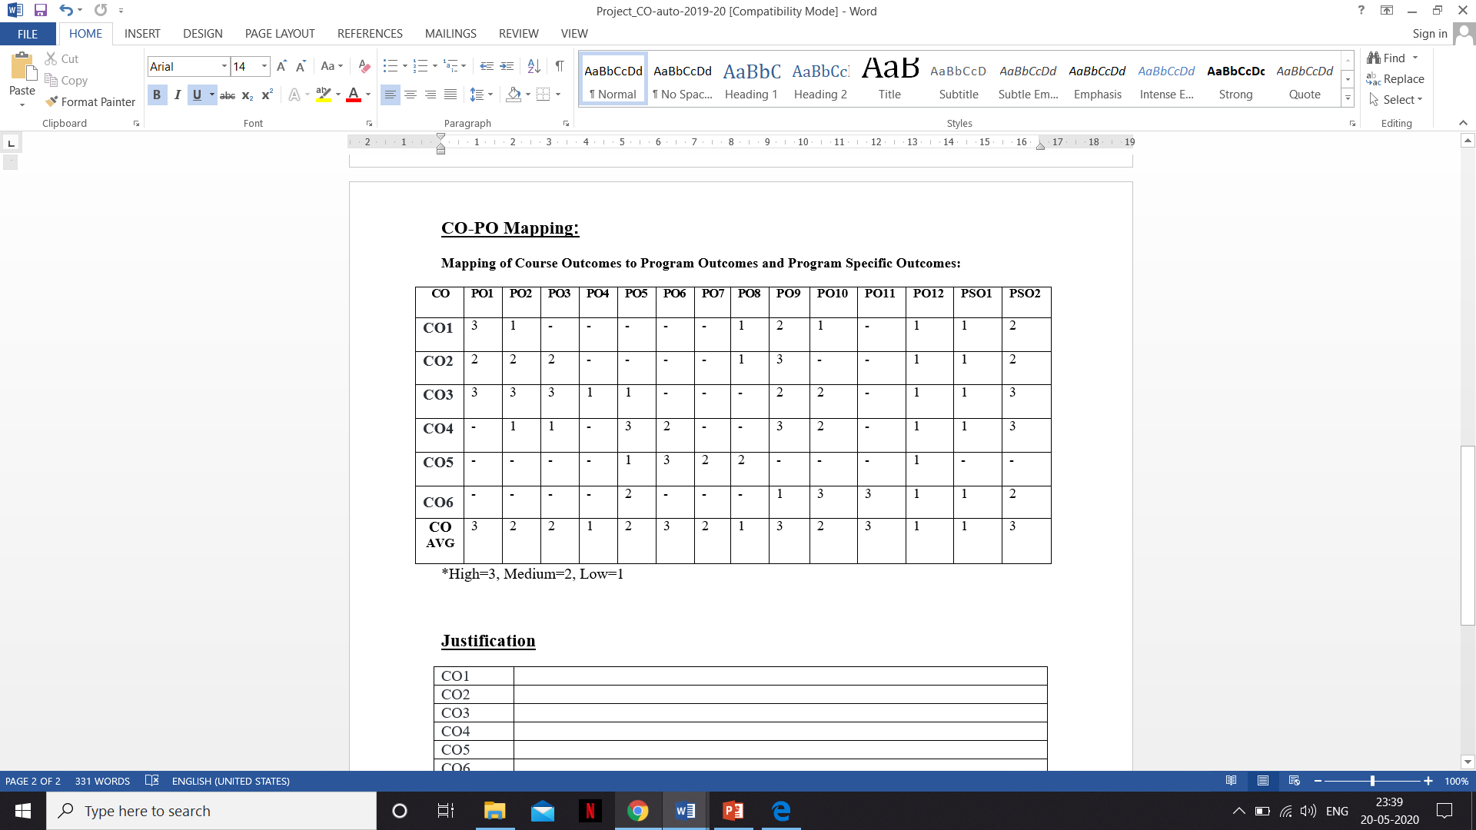
CO-PO Mapping

Slide 4
Budget Planning
HARDWARE | COST in INR
Raspberry Pi 3B+ | 3080
Node MCU | 304
MCP2515 | 230
ADS1115 | 250
Level Sensor | 188
Optical Level Sensor | 2000
Flow Sensor (YF-S201) | 450
Distance Sensor (GP2Y0A21YKOF) | 1145
Electronic Nose Sensor (MiCS55524) | 1144
Continental Temperature Sensor | 4500
Tank Setup x2 | NIL
Gear Tooth Setup | NIL
TOTAL COST: ₹ 13291

Slide 5



INTRODUCTION
Role of Automobile in our life
In this fast age, people need to reach destinations quickly. Automobiles help us achieve that.
Any development has a huge impact on people’s lives.
Since you invest money in vehicle, need to maintain.
Why regular maintenance?
Increased safety: Breakdown of vehicle at deserted places unexpectedly.
Reduced repair cost: Unexpected repairs are very expensive.
Extend life of your vehicle.
The automobile industry strives to produce a vehicle that reduce pollution levels along with other things.
Oh! I didn’t see this coming

Slide 6

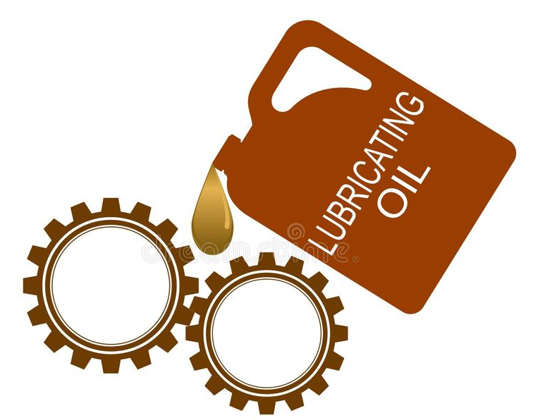
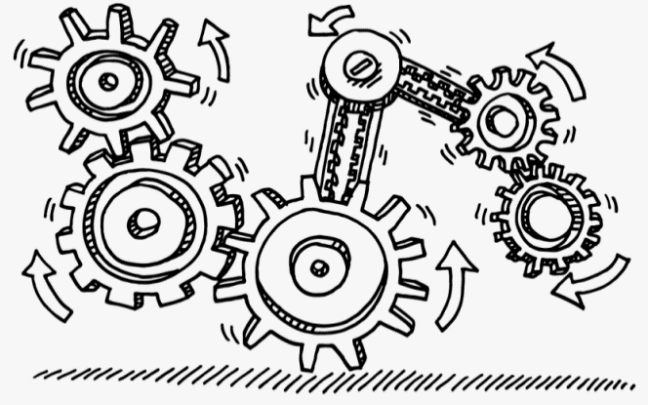
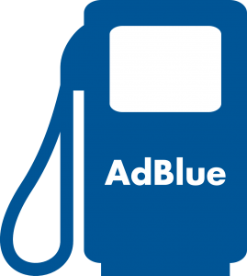
INTRODUCTION
In predictive maintenance we strive to predict the likelihood of failure, so need to monitor the parts that most important parts to functioning of vehicle.
Hence we have found the main reasons for vehicle breakdown
Reasons
Bad engine health and cause engine failure – Lube Oil & AdBlue
Clutch pads and Gear Box being damaged soon
So we are monitoring theses systems using Sensors and Predict.
Thus the main systems are –
AdBlue
Lube Oil
Clutch and Gear
How to Regularly Monitor and Maintain vehicle?

Slide 7

INTRODUCTION
Aim of our Project :
Not the type of maintenance where we tell user the next service deadline.
Regular monitoring is the best solution – for a healthy vehicle and reduce risk of car breakdown unexpectedly.
Here in our project we use sensor technology along with IoT technology to provide real-time information about the vehicle condition to the user and service station for the purpose of EARLY DETECTION.
No more Sudden Breakdowns

Slide 8
LITERATURE SURVEY
[1] Nityanand Kumawat, Parama Pal, Manoj Varma, “Quality Monitoring of Diesel Exhaust Fluid in Vehicles using Diffractive Interference Sensors”, 8th International Conference on automobile and mechanical engineering, IEEE 2014
This paper describes about an optical sensor based on differential interferometry used for quality monitoring of the Diesel Exhaust Fluid (DEF) in the engines. The principle of this operation is based on laser light diffraction from a regularly spaced micro sized 2D grating.
[2] Rachana Khamamkar, Ashru Jadhav, Shreyas Thoke, Prof. Girish Chaple, “Smart Vehicle Safety Monitoring System Using CAN Protocol”, ICAEAE 2016: 10. International Conference on Automobile Engineering and Automotive Engineering, IEEE 2016
In this paper, the effectiveness of CAN protocol used in modern day vehicles is discussed. In order to allow the nodes controllers to interchange without causing any major unsettlement in CAN bus network.

Slide 9
LITERATURE SURVEY
[3] Sidharth Sharma, Supankar Das, Harry Garg, “IoT Based Engine Oil Sludge Monitoring System: A Portable Colorimetric Analyzer”, 4th International Conference on Information Systems and Computer Networks (ISCON), 2019
The adulteration extent of the oil has to be monitored. It is done by IoT based monitoring device that makes use of colorimetric detection method with the use of thin film silver coated mirror.
[4] Ashwin Srinivasan, “IoT Cloud Based Real Time Automobile Monitoring System”, 3rd International Conference on Intelligent Transportation Engineering, 2018
In order to serve the rising demand for efficient cars, dynamic monitoring of cars is required for which a machine learning algorithm- K-Nearest Neighbour is used to predict the vehicle life by assessing the life of engine, coolant and other parts. Ways of communication of this data include via Bluetooth and 4G Dongle to the cloud using Raspberry Pi.

Slide 10
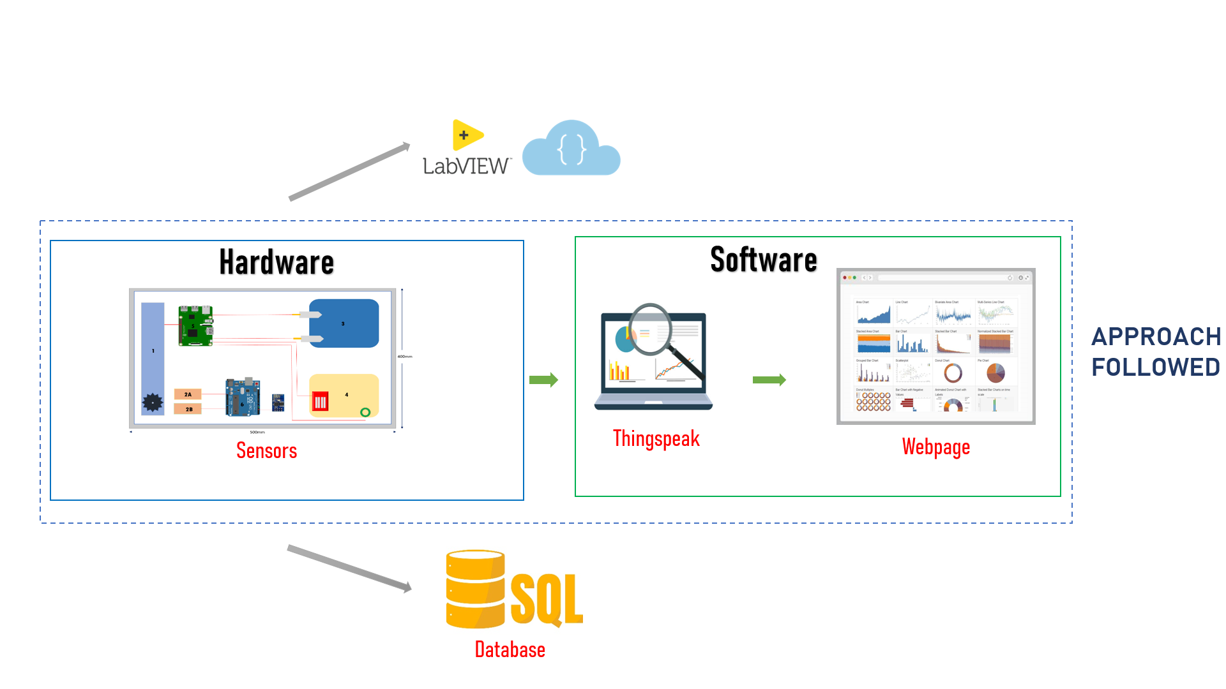
BLOCK DIAGRAM

Slide 11
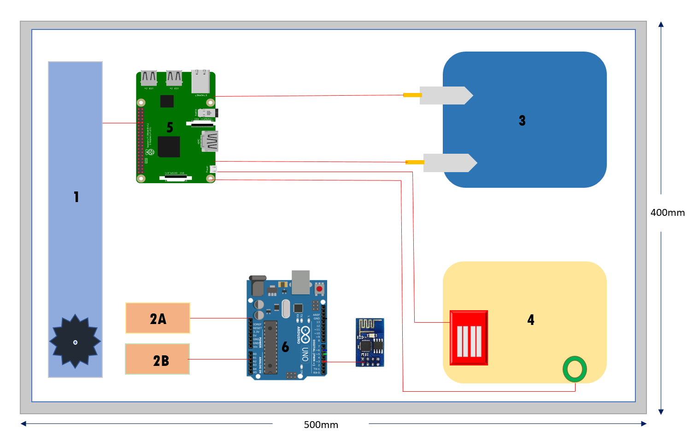
Hardware
Gear tooth wear out detection
Clutch wear out detection
AdBlue monitoring system
Lube Oil monitoring system
Raspberry Pi
Arduino UNO with ESP8266/ NodeMCU

Slide 12


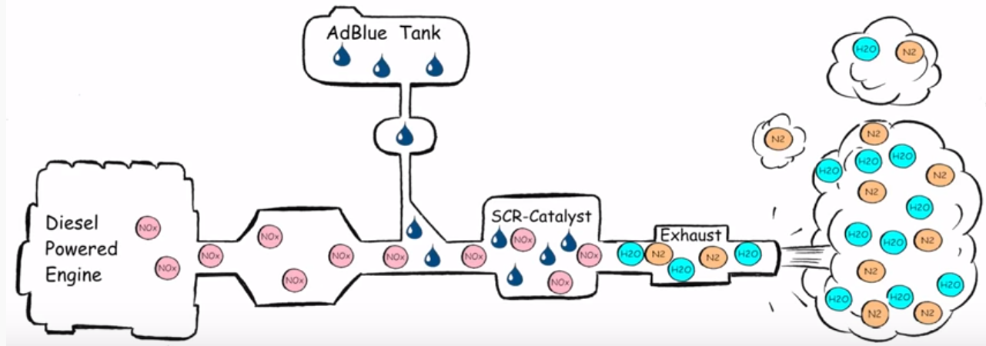
AdBlue Monitoring
WHAT IS ADBLUE? AdBlue is the trade name for a type of diesel exhaust fluid. It's a mixture of urea (32.5%) and deionized water (67.5%) that’s stored in a separate tank from the car’s fuel.
ADVANTAGES
It reduces the emissions of Oxides of Nitrogen NOx at 90%.
It requires minimum and low maintenance cost, SCR system is less sensitive in low quality diesel fuel .
It helps the environment by reducing the number of harmful emissions.
Helps increase the engines' efficiency and help provide around 5% fuel economy.

Slide 13
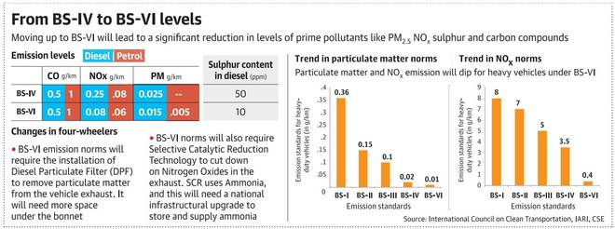
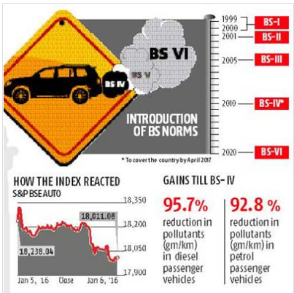
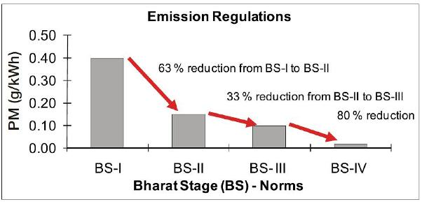
BS-4 vs. BS-6
A comparative study showing reduction in pollutants and help provide a cleaner environment for today and tomorrow.

Slide 14
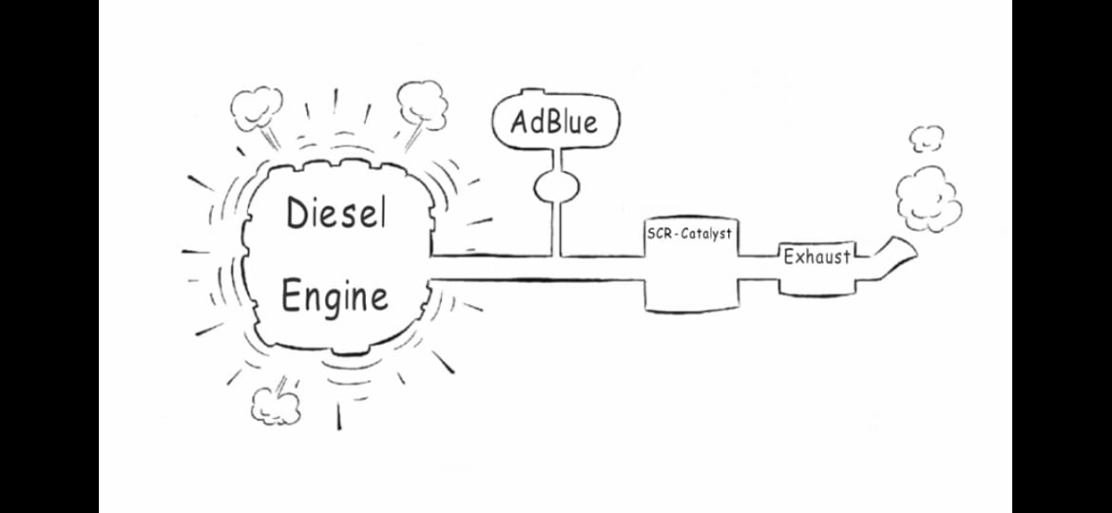
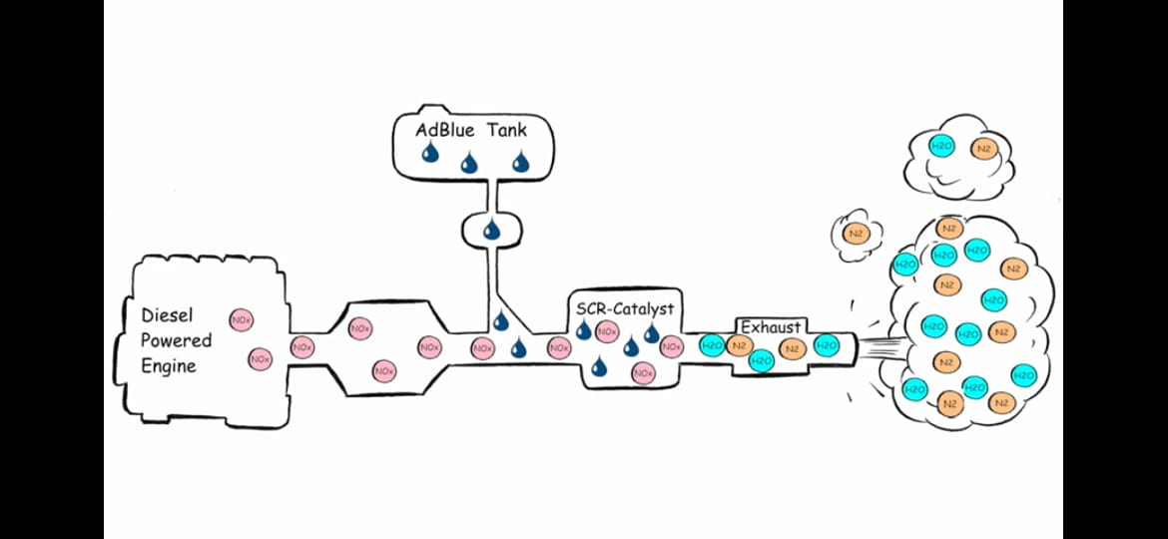


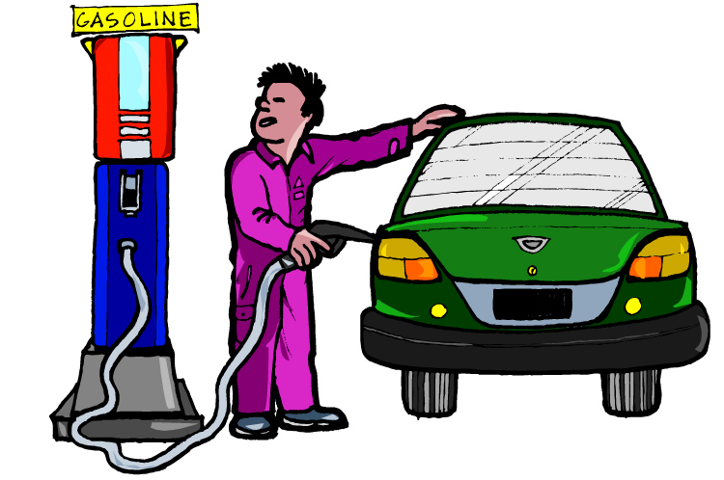
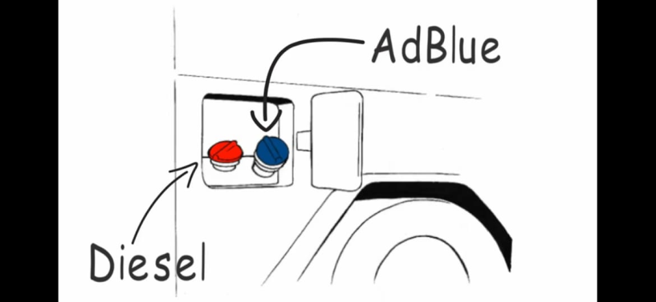

What if we didn’t monitor AdBlue?
If tank not filled on time
Vehicle will come to full stop.
As SCR Catalyst will be blocked
If tank filled with wrong fluid
Need to replace the SCR catalyst since it is damaged.
Engine failure
Hence, replace whole Engine
Pay hefty price.
Water or
any other Fluid
ISO Std. AdBlue
How to avoid this
BILL

Slide 15

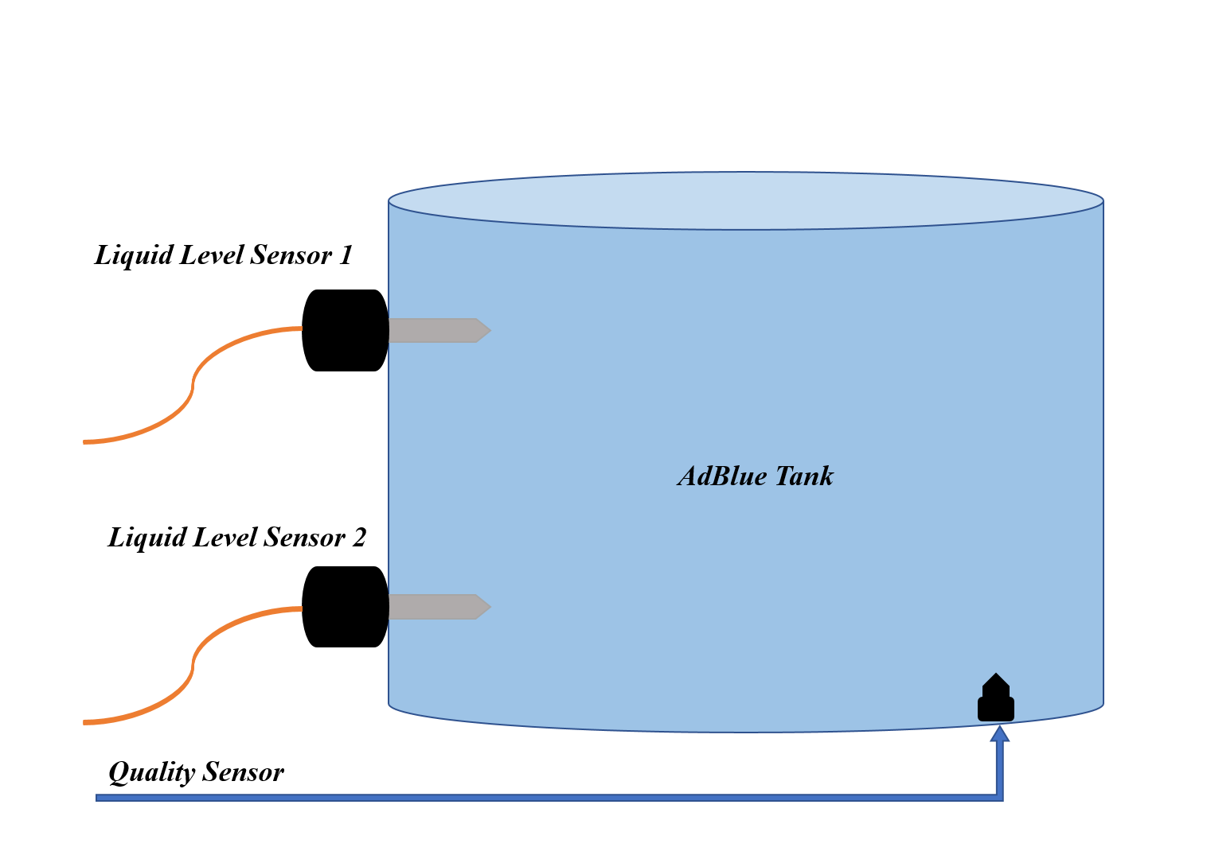
Monitoring System
HOW DOES THIS WORK?
Optical level sensors ,is a polymer or glass sensor tip that houses an infrared (IR) light source and an optical detector.
The sensor utilizes the principle that infrared light is refracted out of the sensor tip when in a liquid, instead of reflected back into the optical detector when in air.
Contaminated AdBlue solution leads to exhaust gas being filtered poorly and solely by the catalyst. This causes- BLOCKAGE in channel leading to low engine performance.
Quality sensor is used to determine contamination.

Slide 16
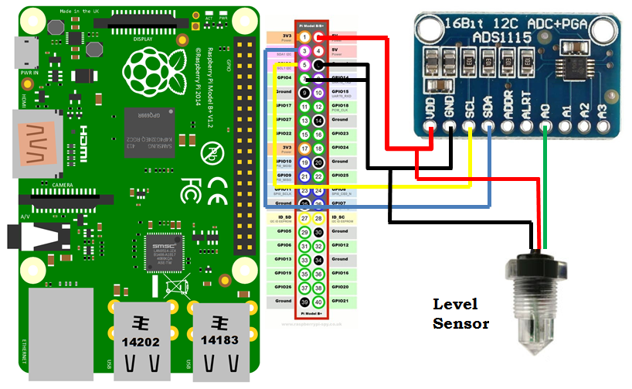
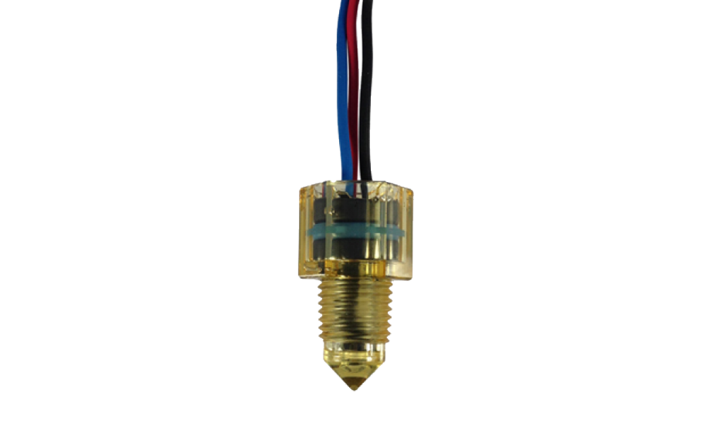
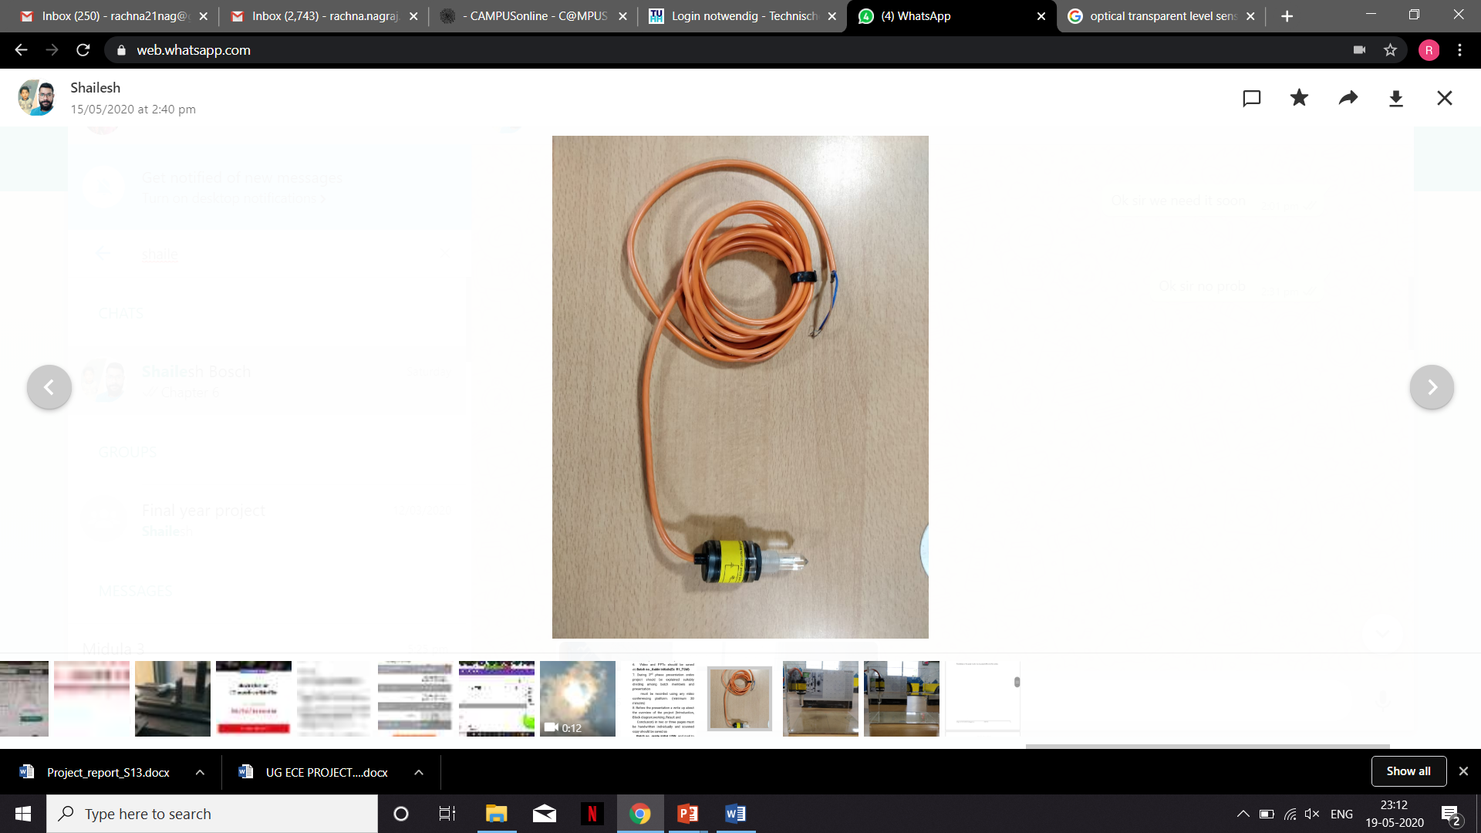
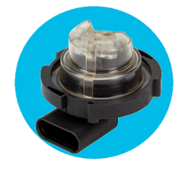
Sensors
Connection Diagram
SST Level Sensor
The keen AdBlue level sensors have low affectability to encompassing light and are not influenced by froth when in air, or little air pockets when in AdBlue Solution
AB Elektronik’s sensor
Supports monitoring of the Adblue tank in order to avoid refuelling with water, diesel or incorrect Adblue concentration

Slide 17

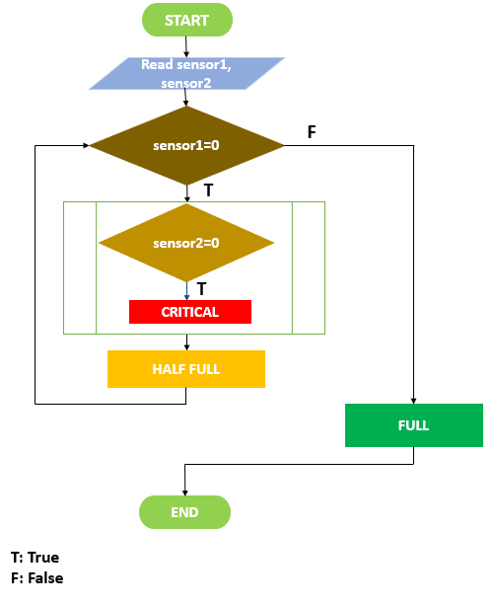
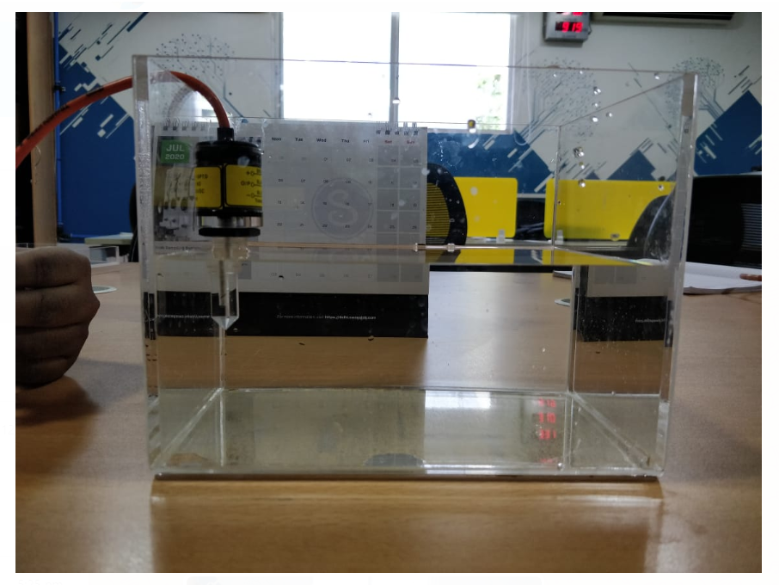
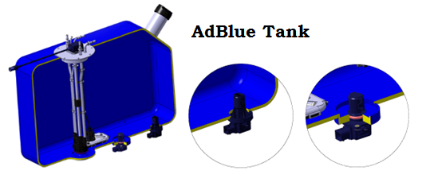
Implementation
WORKFLOW
Level sensor
Quality sensor

Slide 18
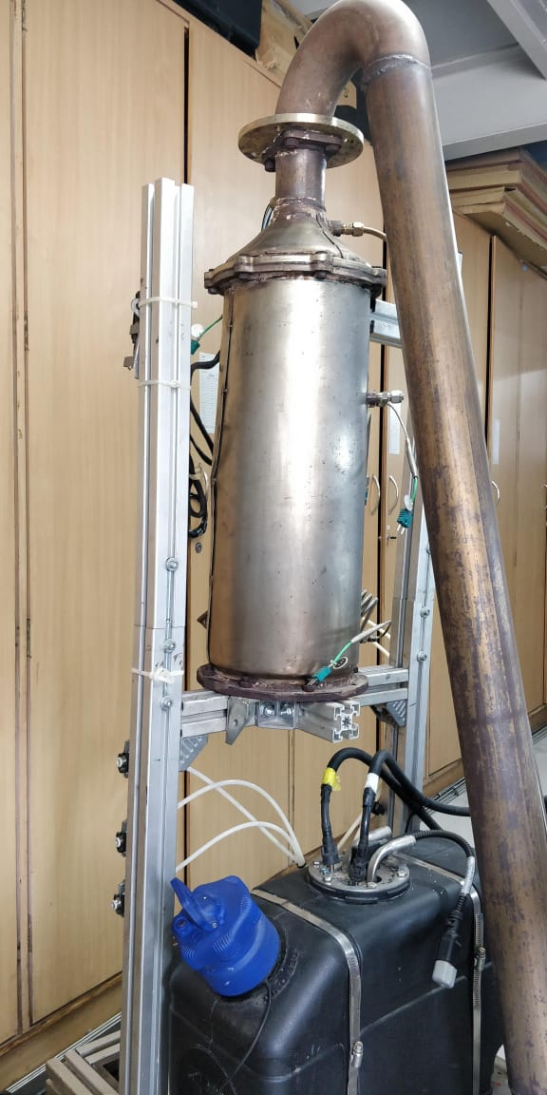
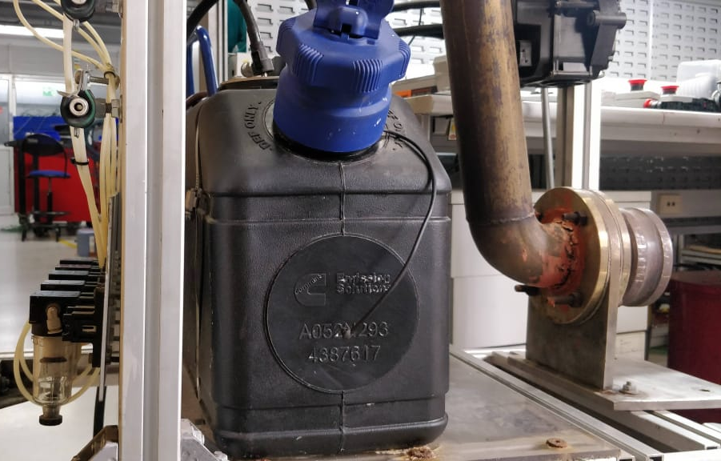
Implementation
The pictures of real AdBlue tank in truck employed in the exhaust system of BS6 engines. CAN quality sensors were tested using MCP2515 module on Arduino

Slide 19
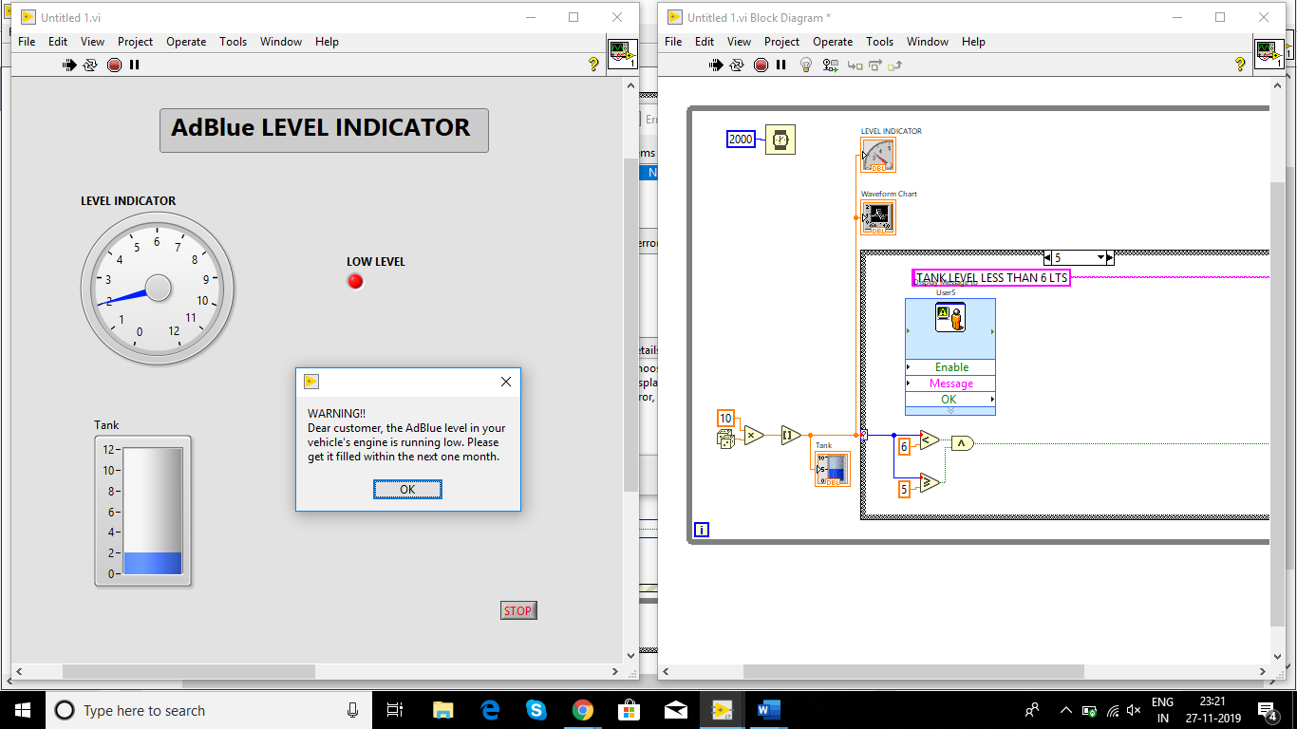
Simulation
Level sensing

Slide 20
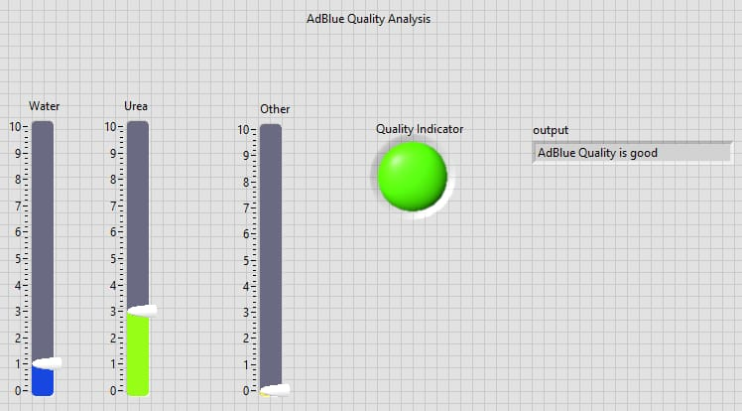
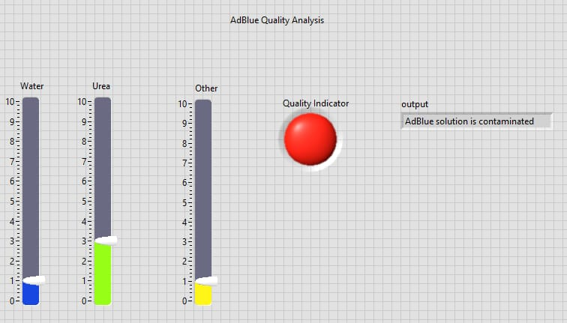
Simulation
Quality Monitoring
Based on water, urea and other substances proportions, quality of DEF is determined
1
2

Slide 21


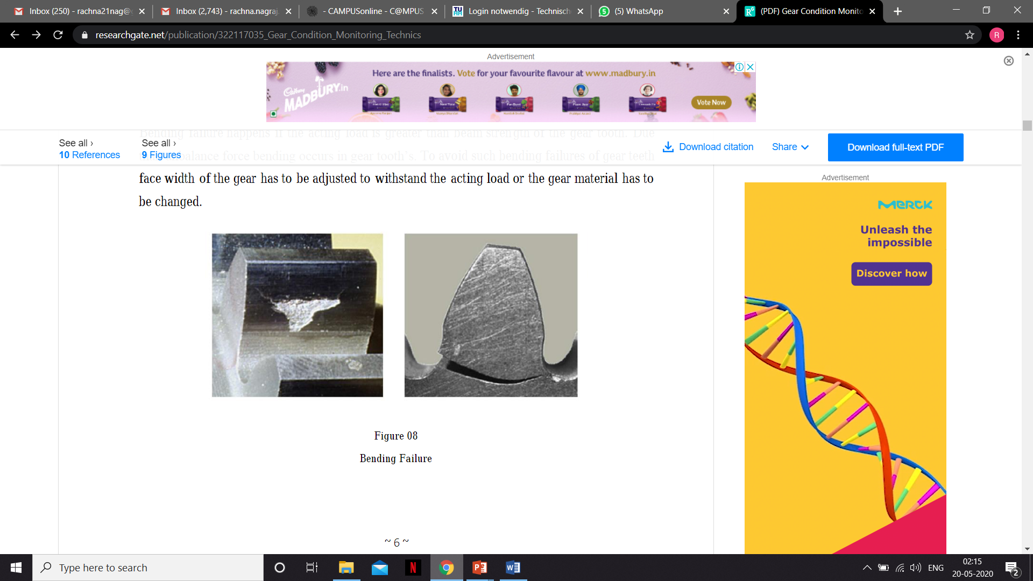

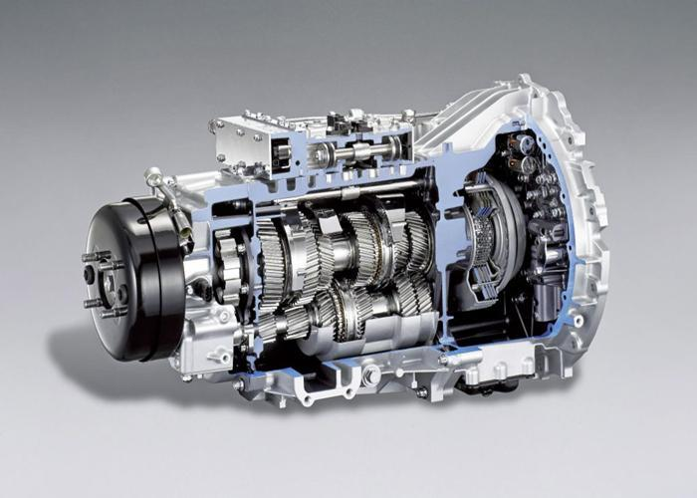
Gear and Clutch Wear Out Detection
Gear
Gear wear and tear happens mostly on automobiles and other
machines.
Specially in automobiles wear and tear happen even the vehicle maintained properly.
SYMPTOMS OF GEAR WEAR OUT
Bending failure happens if the acting load is greater than beam strength of the gear tooth. Due to an unbalance force bending occurs in gear tooth’s.

Slide 22
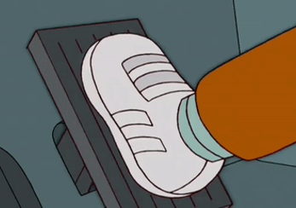
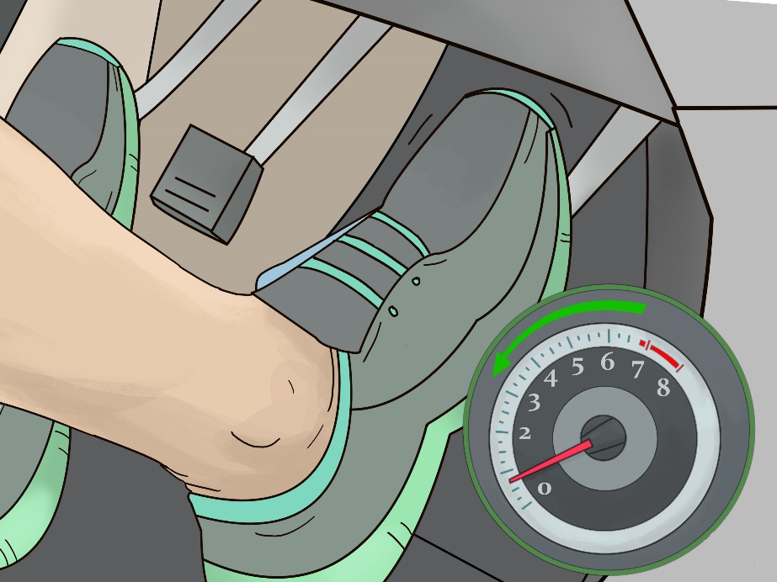
Clutch
Anything that increases the load on the clutch also accelerates wear.
This includes things like towing a heavy trailer, hauling heavy loads in a pickup truck, or spinning the tires in a muscle car.
Poor clutch leads to series of problems that cannot be resolved by themselves
SYMPTOMS OF CLUTCH WEAR OUT
ADVANTAGES OF EARLY DETECTION
Clutch slipping
Trouble shifting gears
Burning smell
Clutch pedals stay on floor
1. Prevention of unexpected breakdown of vehicle
2. Less expenditure on service
3. Longevity of vehicle health

Slide 23

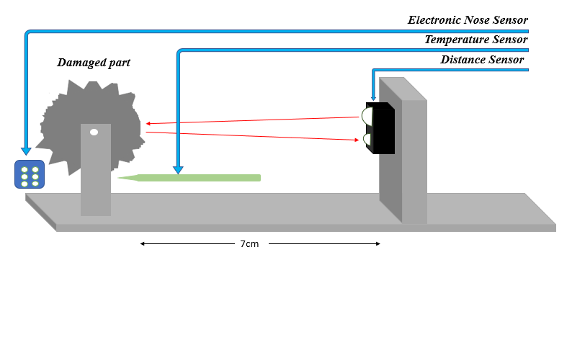
Wear Out Detection System
HOW DOES THIS WORK?
Gear:
A damaged gear wheel is considered with a precision distance sensor attached perpendicular to it in order to detect damaged tooth.
Distance sensor is composed of an integrated combination of
PSD (position sensitive detector) , IRED (infrared emitting diode) and signal processing circuit.
Clutch:
Electronic nose and CAN based temperature sensor are employed to detect the overheating of clutch since overheated clutch pads due to friction smell like any hydrocarbon.

Slide 24
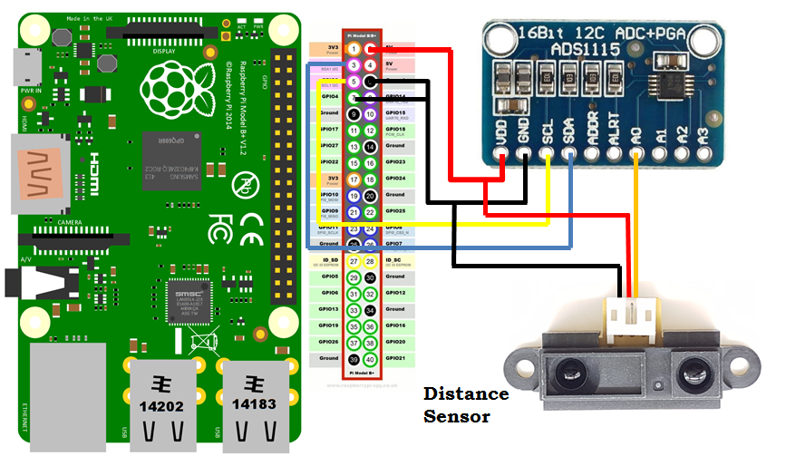
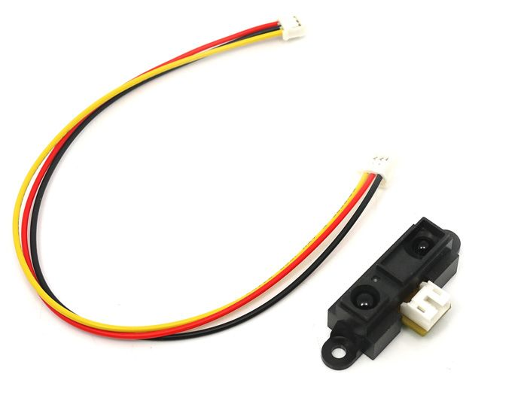
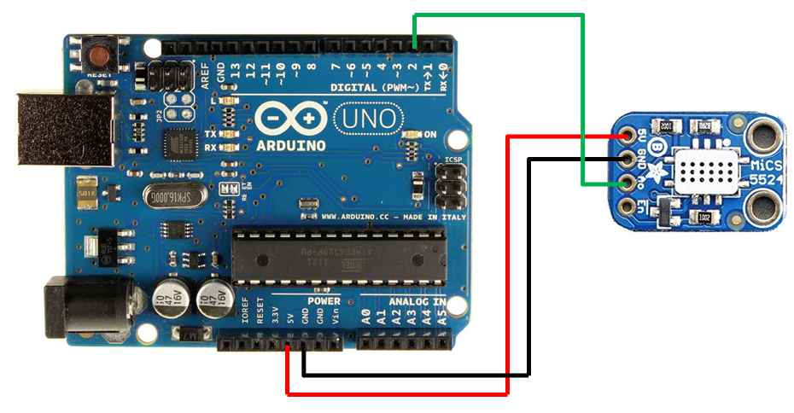
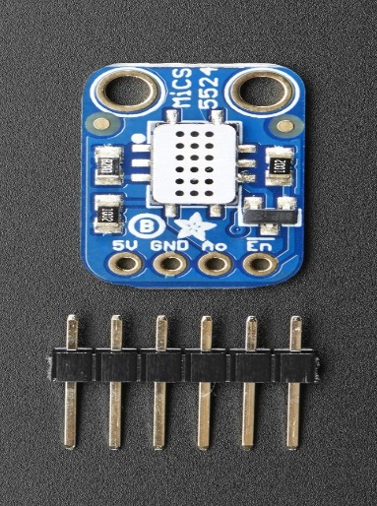
Sensors
Connection Diagram
GP2Y0A21YK0F IR sensor
Gives a simple yield with a scope of 10 to 80 cm. Fixed at 7cm away from the gear tooth for ease of programming. Gives analog output.
MiCS-5524 sensor
Indoor carbon monoxide and gaseous petrol spillage location. Appropriate additionally for indoor air quality observing. Early fire recognition

Slide 25
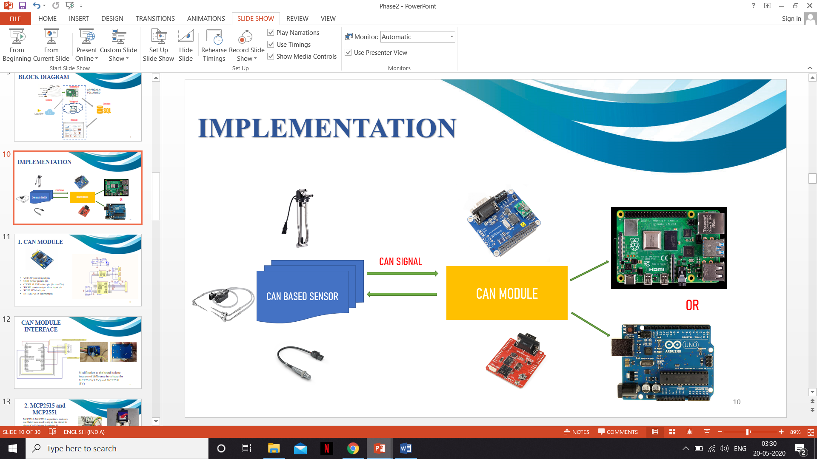
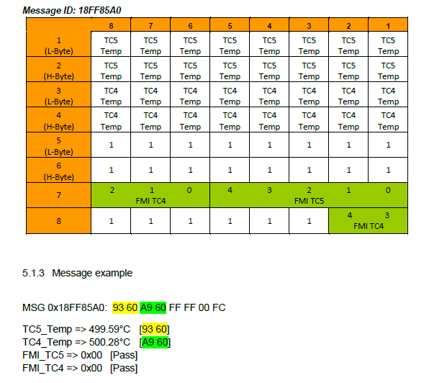
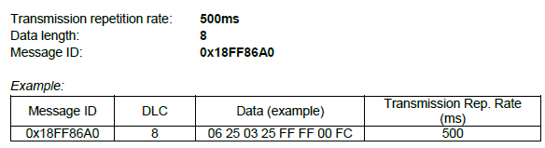
Sensors
CAN based Temperature Sensor by Continental
CAN stands for Controller Area Network invented by Robert Bosch for automobile in vehicle network
The data is streamed in HEX format.
There are two lines present- CANH (CAN High) and CANL (CAN Low)
CAN message format

Slide 26

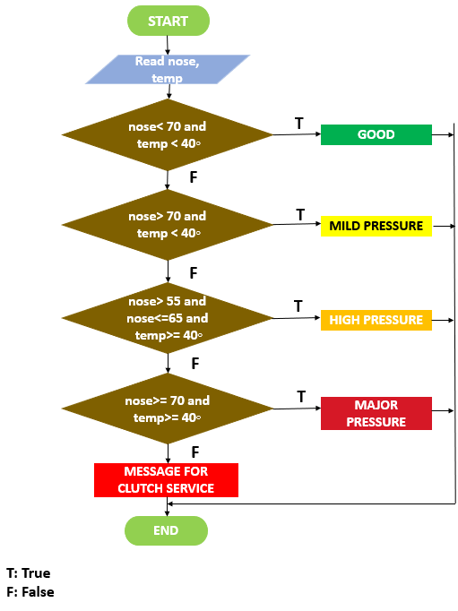
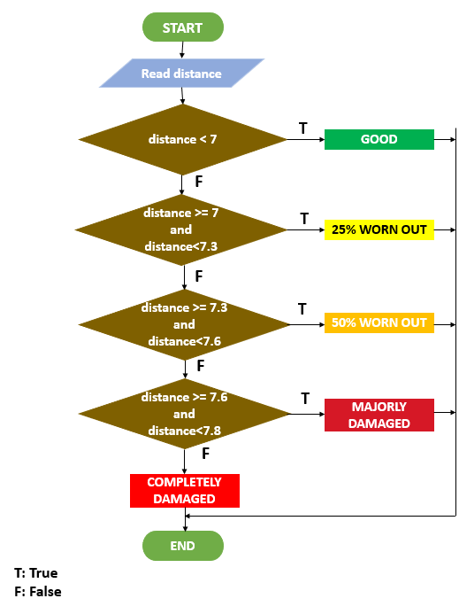
Implementation
GEAR WEAR OUT WORKFLOW
CLUTCH WEAR OUT WORKFLOW

Slide 27
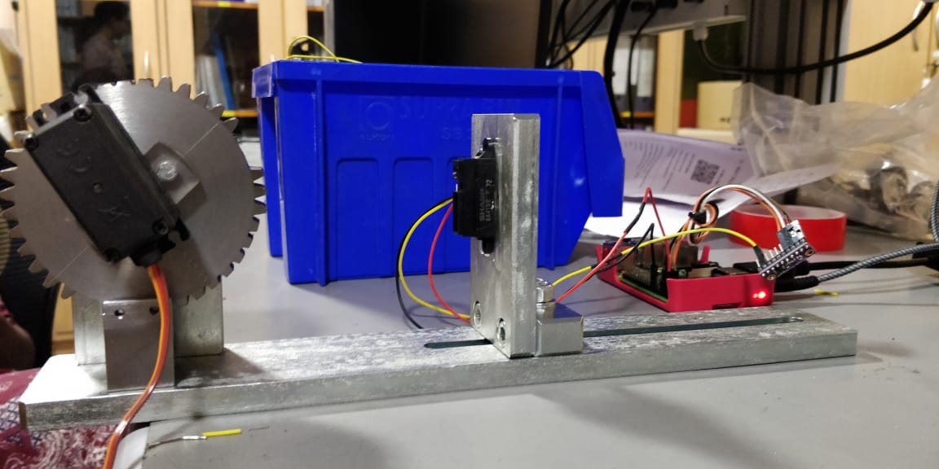
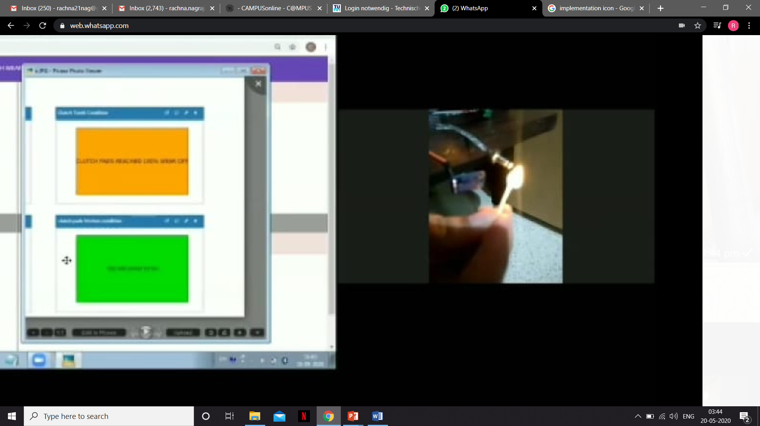
Implementation
GEAR WEAR OUT HARDWARE SETUP
CLUTCH WEAR OUT HARDWARE SETUP

Slide 28
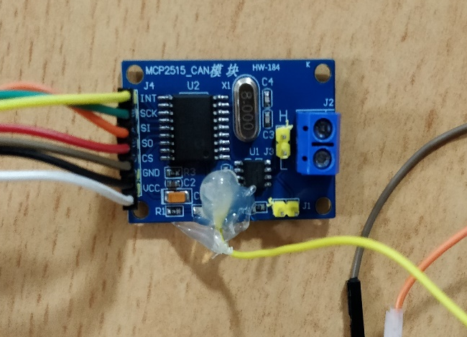
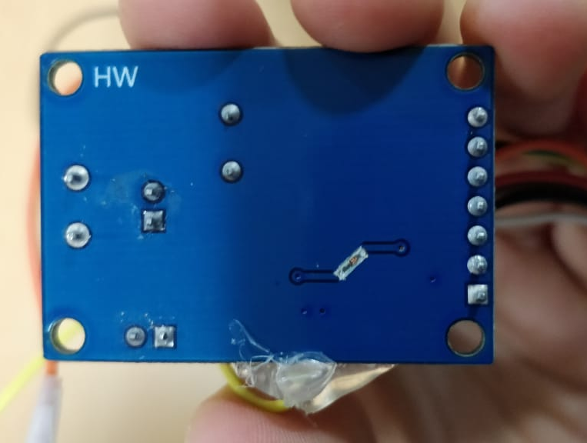
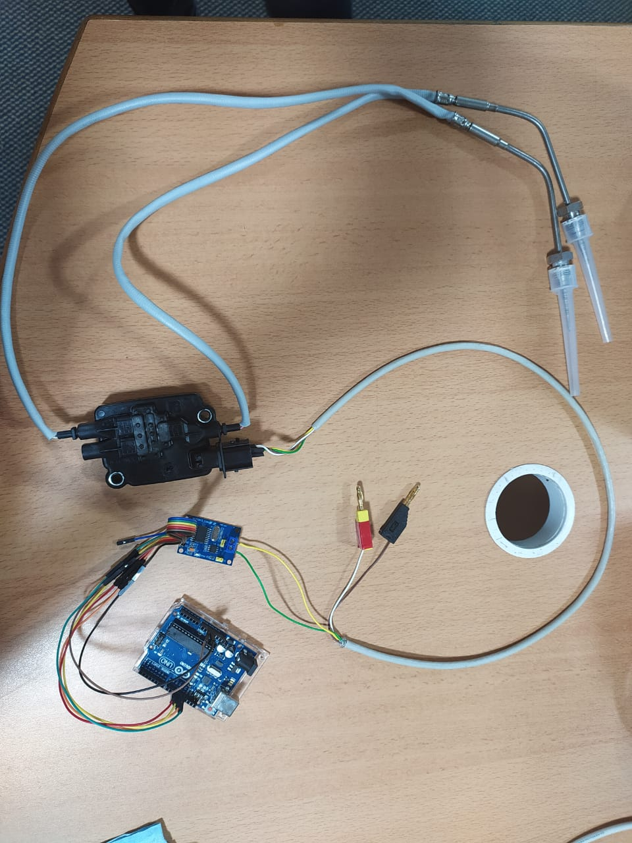
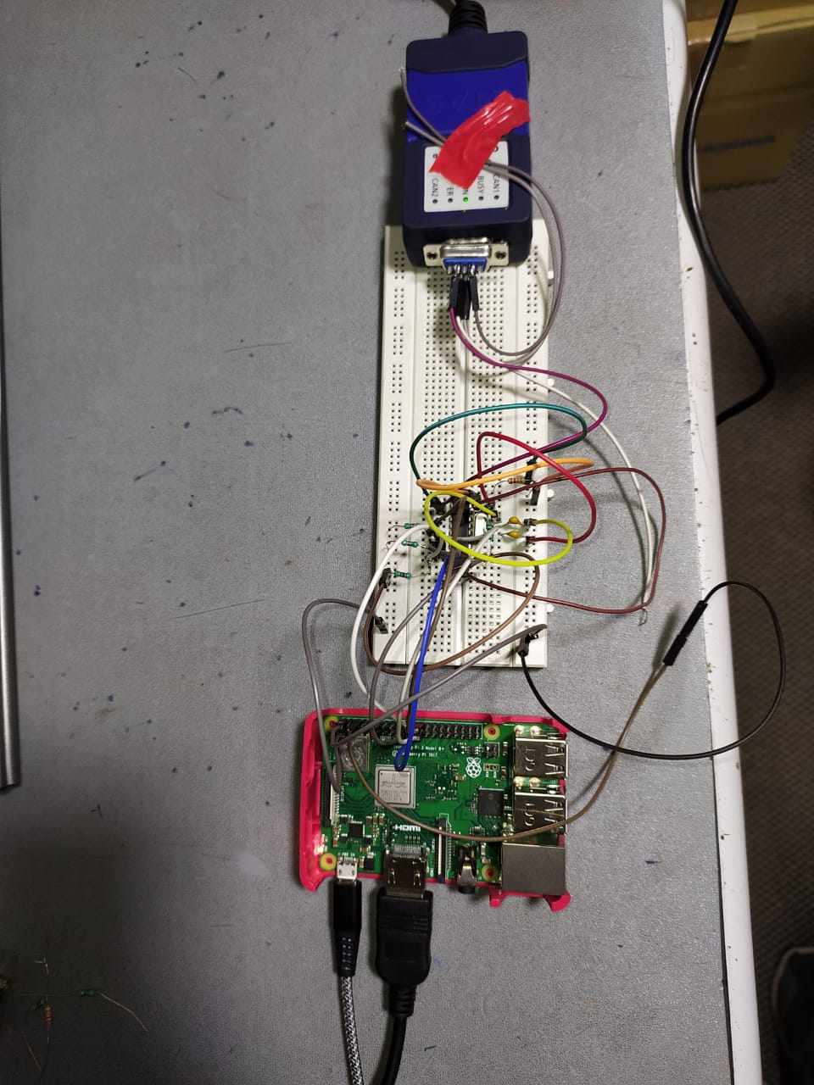
Implementation
Experimentation on CAN sensor
Modification of MCP2515 Module
CAN-Temperature sensor connection with MCP2515 module to Arduino
Transmission of CAN signals to ETAS module for signal analysis on BUS Master software

Slide 29

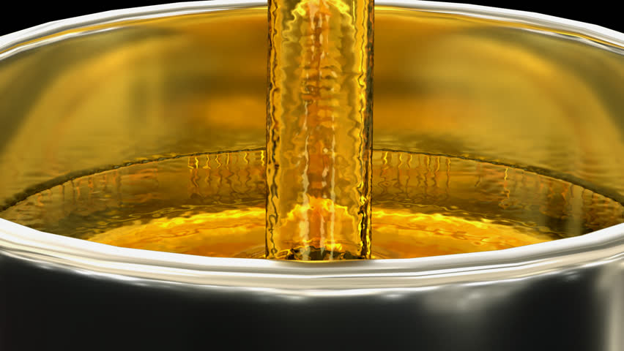

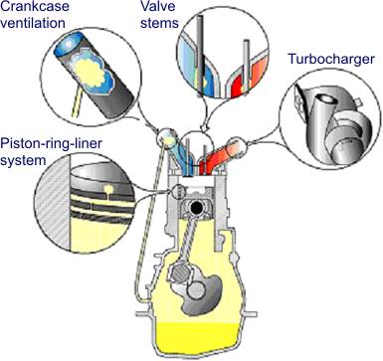
Lube Oil Monitoring
WHAT IS LUBE OIL? Engine lubricants consist of a base oil (typically 75 - 83%),
viscosity modifier (5 - 8%) and an additive package (12 - 18%)
Wear reduction of components such as bearings, pistons, piston rings, cylinder liners and the valve train.
IMPORTANT FUNCTIONS
Lubricates the rotating and moving parts and gears of the engine to minimize the effects of metal to metal contact
Absorb great amount generated heat to achieve smooth performance
Lengthening the life of the internal parts of the engine

Slide 30
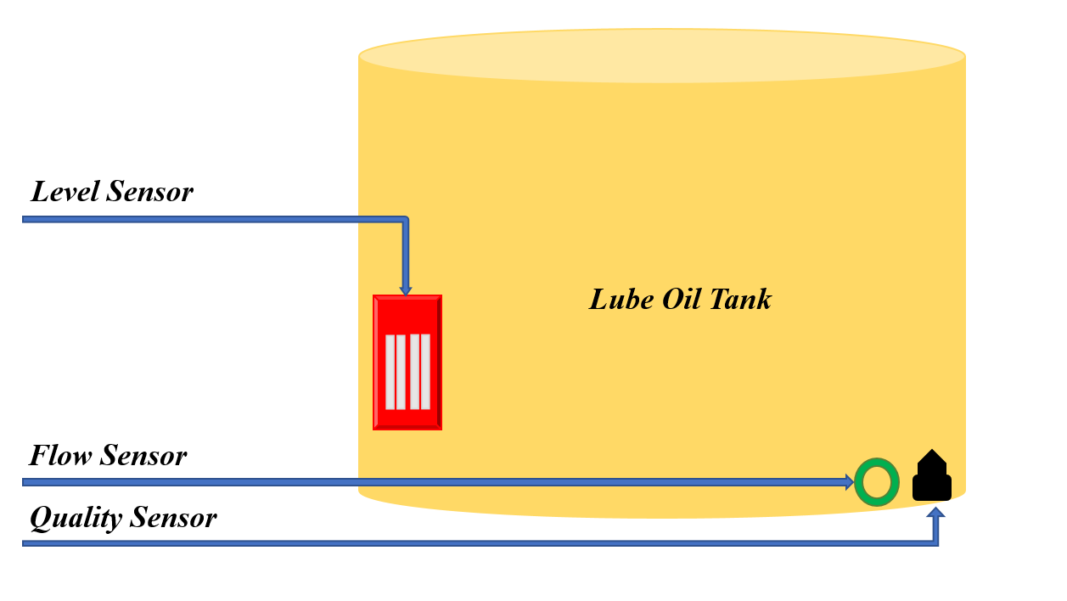
Monitoring System
HOW DOES THIS WORK?
Oil level switch is an analog sensor like float switch that can measure the level of any dense liquid like lube oil.
Once the oil in the tank reaches its lowest predetermined point (closed position) the reed switch will create a circuit and automatically send a signal to your pump to start filling your tank up with oil again
Flow sensor is used to detect any leakage of the lube oil
Quality sensor is used to determine contamination which otherwise leads to damage of engine parts

Slide 31





Sensors
Connection Diagram
Level Sensor
Analog sensor that depicts 4 levels of lube oil. Can be defined for more values for precision
FPS2800 is a fluid property sensor
Measures the viscosity and density of lube oil
YF-S201 Hall Effect Flow Meter
Measures basic square wave so it’s very simple to log and convert into litres every moment utilizing the accompanying recipe.

Slide 32



Implementation
WORKFLOW
1
2

Slide 33



IoT and ThingSpeak
Open-Source IoT platform
Data logging (store)
Retrieve data using HTTP protocol
Analyze, Visualize using MATLAB
Act on data in Web site

Slide 34




Why choose ThingSpeak ?
It provides a free IoT platform for real time project. (open source API)
ThingSpeak provides a single platform for sensor data acquisition, data logging and analysis using Matlab .
Compared to AWS which requires different services for data acquisition, logging and analysis.
Status context (message display ).
User doesn’t require to install Matlab, which is apt for the purpose of this project.

Slide 35


Each channel has max of 4 fields, each field can access data from only one Sensor
Experimental channel
Channel 1
Channel 2
Channel 3
Level Sensor data in One field in from of Graph

Slide 36


Slide 37




Web Site
Development of an interactive Web Site using Angular JS.
Open source front-end web framework.
Home page provides general info. On each system
Give real time and live data to
User ( vehicle owner)
Service station
Important feature – Provide the LOCATION of nearest service station based on vehicle’s current location.
Why Angular JS?
Helps create web page AND design the page
Compile everything ( No HTML & CSS)
Easy to test and debug.
http://vehicle-monitor.surge.sh/ Link to Web Site

Slide 38


Slide 39



RESULTS
The desired output is displayed on the webpage that is deployed and an SMS is sent to the customer at critical conditions
This page is accessed by both customer and the service center for monitoring the health. The sensors are successfully sending data to the website.

Slide 40


RESULTS
BQ-MARSUZ
WEBSITE- provides precise data for over a span of few days
SMS- an alert at critical conditions only

Slide 41





CONCLUSION
In a nutshell, a vehicle safety monitoring system predicted on the IoT Platform is an efficient and real-time solution for the transfer of information to the user.
Accurate for early detection for any vehicle break-downs by analysing the sensor data and cumulative analysis of the old data.
Early detection of any damage reduces the expenses on service and ensures safety.

Slide 42






APPLICATION & ADVANTAGE
MAIN APPLICATION -IT IS A BIG LEAP IN THE SELF DRIVING AND AUTONOMOUS VEHICLE INDUSTRY
AN ATTEMPT TO REDUCE POLLUTION AND PROTECT THE ENVIRONMENT

Slide 43


TIMELINE
AUG to SEPT- Research and Literature Survey
OCT to DEC- Development of block diagram and introduction to interfacing of sensors with Raspberry Pi using Python.
Simulation of AdBlue level sensing and error message display using LabVIEW
JAN to FEB- Use of various analog sensors to acquire data. Study of CAN sensors and interface with Arduino UNO. Pushing acquired data to ThingSpeak
FEB to MARCH- Rig up of all sensors together and pushing data to webpage and analysis. To provide users with friendly webpage and also help service centres in inventory
APR- Final implementation of both hardware and software together and aim to implement for multiple vehicles

Slide 44

REFERENCES
[1]Nityanand Kumawat, Parama Pal, Manoj Varma, “Quality Monitoring of Diesel Exhaust Fluid in Vehicles using Diffractive Interference Sensors”, 8th International Conference on automobile and mechanical engineering, IEEE 2014
[2] Fatin Balkis Binti Alzahri, Maziani Sabudin, “Vehicle Tracking Device”, IEEE International Conference on Internet of Things and Intelligence System, IEEE 2016
[3] Thorsteinn Rögnvaldsson, Sławomir Nowaczyk, Stefan Byttner, Rune Prytz, Magnus Svensson, “Self-monitoring for maintenance of vehicle fleets”, Springer Publication, August 2017.
[4] https://www.can-cia.org/can-knowledge/can/can-history/
[5]https://www.bosch.in/our-company/bosch-in-india/bangalore/
[6]https://www.circuitbasics.com/basics-of-the-spi-communication-protocol/
[7] Alrifaie, Mohammed & Harum, Norharyati & Othman, Mohd Fairuz Iskandar & Roslan, Irda & Shyaa, Methaq, “Vehicle Detection and Tracking System IoT based: A Review”, International Journal of Engineering and Technology. 5. 1237-1241, 2018

Slide 45

I AM POLLUTION FREE!

